Slide 1
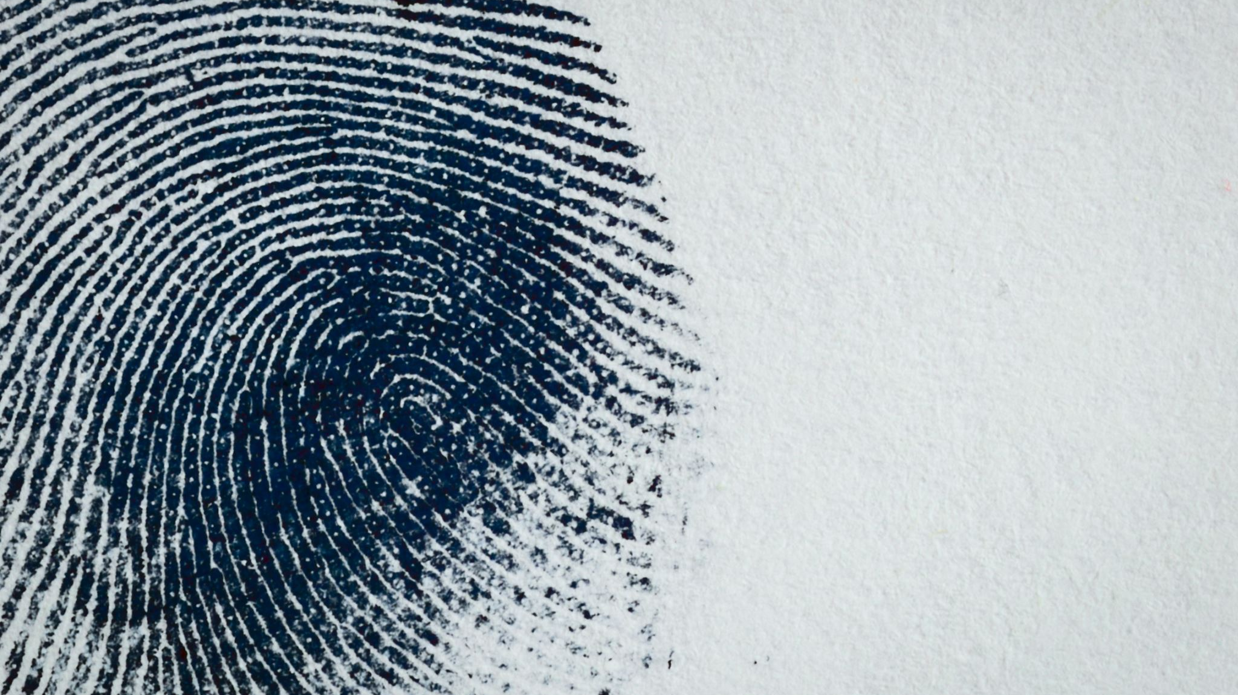
Clarifai AI:
Autonomous Weapons Development

Slide 2
Ethics and AI
Who decides what’s right and what’s wrong
What is on the line?
Human life
Ethical human living
Trillions of dollars
What is happening right now?
Engineers are fighting back
Companies are doubling down
Government considering getting involved

Slide 3
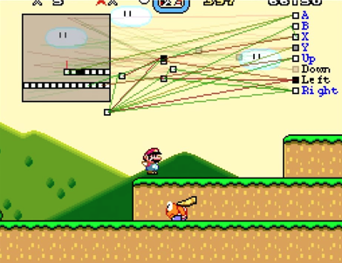
Ethics and AI
AI is already here. What are we going to do about it?

Slide 4
Ethics and AI
How can we control something that we don’t understand?
Defending against data violence?
Where is the kill switch?
What has happened historically?
Subproblem: We’ve never seen this before…

Slide 5
Ethics and AI
Advanced Technology
Bright Engineers
Big egos
Societal problems

Slide 6

Ethics and AI
What to do?
Continue
Stop
Slow
Who’s affected?
Everyone
Future generations
More towards minorities
What would I do?
Continuing = Destruction
Stopping is impossible
Slowing is our only chance

Slide 7
Overview of Clarifai
Founded in 2013 by Matt Zeiler
“Whiz Kid” PhD
2015 - Closed Series A ($10M)
2016 – Closed Series B ($30M)
Founding mission: Improving Life
Secured government contract
Project Maven
U.S Gov scheduled to redefine statement on autonomous weapons
Officially taken a stance to ‘contribute to autonomous weapons’ in response to employee letter

Slide 8
You’ve been hacked… Game Over?
Clarifai hack
Untargeted bot accessing research server
Concerns brought up internally
Was reported several weeks later

Slide 9
You’ve been hacked… Game Over?
Questions:
How do you defend against your drones getting hacked in the open world?
What are the consequences of reporting?
How did this happen?
How do we prevent this?
Resources:
Communication channels
Money
Talent
Significant progress

Slide 10
You’ve been hacked… Game Over?
What are your options?
Fix things and then:
Report the hack
Keep the hack a secret
Who is affected by each option?
Clarifai
Clarifai employees
…the Pentagon
v.s

Slide 11
Autonomous Weapons
Should Clarifai (or anyone) be contributing to the development of autonomous weapons?

Slide 12
Autonomous Weapons
What rules apply?
N/A – that’s the problem
What questions would you ask?
Can you guarantee humans will always be a part of the question for who lives and dies?
Why are we so confident in AI when it’s just starting to work?
Who is responsible when bad things happen?
Do the risks offset the benefit?
How much is the military going to be allowed to use this?

Slide 13
Autonomous Weapons
What resources do you have?
Massive government contracts
Talent
Technology
Lack of legal barriers
What are your options?
Build and utilize tech
Ban it and protect people
Who is affected by each option?
As always with AI – everyone
Affects targets by death
Minorities more likely to be targeted

Slide 14
Previous Employee
“
Clarifai started doing these contracts to make a lot of cash. The CEO had an option to sell the company multiple times, and turned buyout offers down. He was very controlling, and so when key hires left as a result, it looked bad to the board. He didn’t want to have to raise money again, because they might take his CEO seat away. So he took on government contracts, didn’t tell employees what they were working on, and it kind of spiraled from there until the company fully pivoted. I’d say that the big problem with ethics in AI is that humans with egos drive AI forward, and sometimes they really only think about covering themselves rather than doing what’s right.
”
– Anonymous past employee

Slide 15
Takeaways
AI is here and it’s not going away
We need to be more responsible as a society
Stopping AI is an invalid option
Big egos drive things forward
Your career follows you

Slide 16
Extended Resources:
http://www.ktvu.com/news/employees-of-big-tech-are-speaking-out-about-ethical-issues-like-never-before
https://www.npr.org/2019/05/13/722909218/when-technology-can-be-used-to-build-weapons-some-workers-take-a-stand
https://assets.documentcloud.org/documents/5999930/Open-Letter-to-Clarifai.pdf (amazing letter written by former employee Liz O’Sullivan)
https://www.forbes.com/sites/aarontilley/2017/07/13/clarifai-ai-image-recognition/#58ec98b6fe42 (Founder and whiz kid)
https://www.clarifai.com/blog/why-were-part-of-project-maven

Slide 17
Extended Resources:
https://www.aclu.org/blog/national-security/targeted-killing/i-quit-my-job-protest-my-companys-work-building-killer
https://www.wired.com/story/startup-working-on-contentious-pentagon-ai-project-was-hacked/
https://venturebeat.com/2018/06/13/ai-startup-clarifai-hacked-by-russian-source-while-allegedly-part-of-pentagons-project-maven/
https://www.nytimes.com/2019/03/01/business/ethics-artificial-intelligence.html
https://www.nymetroparents.com/article/This-Weekend-s-Kids-Family-Activities-in-Bronx-20170405

